Slide 1
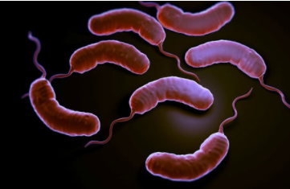
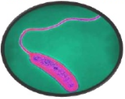
Vibrio,and related organisms
( Aeromonas &plesiomonas)
Prof. Dr. Lamyaa Kadhim Baqer
Medical bacteriology
Third year

Slide 2
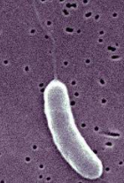
General Characteristics of Vibrio, Aeromonas , and Plesiomonas
Vibrio , Aeromonas , and Plesiomonas species are gram negative bacilli that are all widely distributed in nature. Primarily found in water sources.
They cause gastrointestinal disease
Similarities to Enterobacteriaceae
.Gram-negative
.Facultative anaerobes
.Fermentative bacilli
Differences from Enterobacteriaceae
.Having polar flagella (in contrast to peritrichous flagella of the motile Enterobacteriaceae).
.Oxidase positive

Slide 3
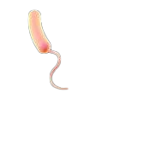
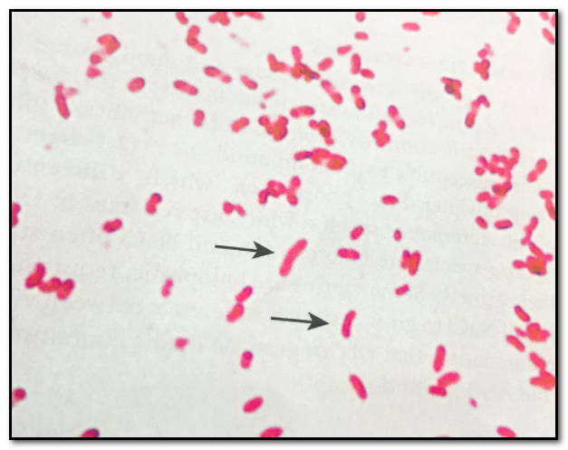
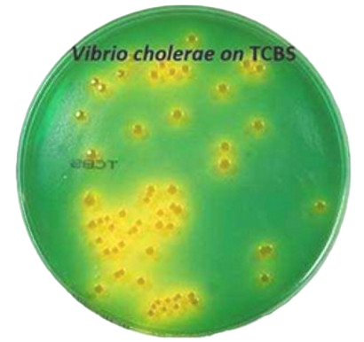
The Vibrios
Morphology and physiology of Vibrios
-They are comma-shaped (vibrioid) gram negative bacilli, are motile possessing a polar flagellum. They belong to the family Vibrionaceae .The most significant human Vibrios are : V. cholerae, V. parahaemolyticus, and V. vulnificus.
--Broad temperature and pH range for growth on media:
.18 -37° C .PH 7.0 – 9.0 (useful for enrichment). - For rapid isolation from faeces , Alkaline Peptone Water APW ( pH 8.6) is used (enrichment medium for V. cholerae ).
-Vibrios can grow on a variety of simple media such as ,blood agar and MacConkey`s agar. The selective medium is TCBS agar (Thiosulfate Citrate Bile salts Sucrose agar )
- V. cholerae grow without salt. Most other Vibrios are halophilic ( salt-loving).

Slide 4
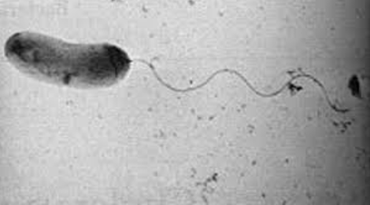
VIBRIO CHOLERAE
Morphology and Identification
Vibrio cholerae :
Gram-negative ,facultatively anaerobic, fermentative comma-shaped ,curved rods
2-4 µm long
Actively mobile by means of a polar flagellum

Slide 5
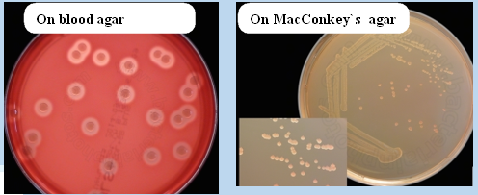
Culture
Vibrio cholerae can grow on a variety of simple media like blood agar and MacConkey`s agar with a broad temperature range from (18° C to 37° C) . And tolerate a wide range of pH (7.0 to 9.0) but are susceptible to stomach acids.
V.cholerae grows well on thiosulfate-citrate-bile-sucrose (TCBS) agar ,which is the selective medium for Vibrios.

Slide 6
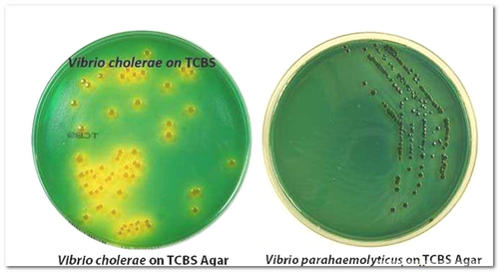
On TCBS
V. cholerae produces large (2–4 mm in diameter) yellow-colored colonies, slightly flattened with opaque centers and translucent peripheries.
The yellow color is due to the fermentation of sucrose in TCBS medium.
Non-sucrose-fermenting Vibrios such as V. parahaemolyticus produce green to blue-green colonies.

Slide 7
Antigenic structure and Biologic Classifications
Many Vibrios share a single heat -labile flagellar H antigen which is nonspecific.
-V.cholerae has O liposaccharides antigens that give serological specificity.
Based on variable somatic O-antigen composition ,more than 200 O antigen groups of V. cholerae have been recognized
1- O1 serogroup
V. cholerae strains of O1 and O139 serogroups cause classic epidemic cholera
( both are toxigenic)
Occasionally non-O1/non-O139
V.cholerae causes cholera-like disease
-These V. cholerae serogroups O1 antigen have extra determinants that make possible further typing:
the serotypes are Ogawa, Inaba, and Hikogima .
-Two biotypes of epidemic V. cholerae (different biochemical reactions)
1-Classic 2-El Tor
Include other strains that are identical to O1 strains but do not agglutinate in O1 antiserum
They are called:
Non-cholera Vibrios (NCV) or Non-agglutinating (NAG) Vibrios
(O139 serogroups)

Slide 8
Laboratory Diagnosis of V. cholerae
A-Specimen
B-Smears
C-Transport media
D-Culture
E-Specific Tests
A- Specimens:
specimens for culture include watery stool and mucous flakes from patients or carriers.
B- Smears:
The microscopic appearance of smears made from stool samples is not reliable. Under dark-field microscopy ,the rapidly motile Vibrios might be seen (darting movement ) .

Slide 9
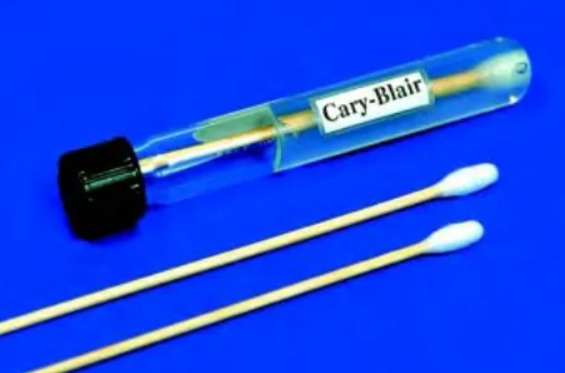
C- Transport media:
The ideal transport medium is Cary Blair media ,
and if not available, Alkaline Peptone Water (APW) can be used.
D- Culture:
Culture is the gold standard in the isolation and diagnosis of the organism from the stool sample.
Vibrio can grow on a variety of simple media like blood agar and MacConkey`s agar
Selective / differential medium is thiosulfate-citrate-bile salts agar (TCBS) producing yellow colonies.
Enrichment medium is Alkaline peptone broth
(high pH 8.0-9.0 : vibrio can survive and replicate while other organisms can not)

Slide 10
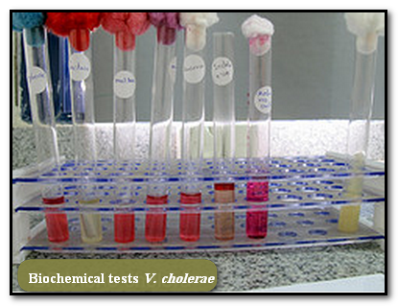
E-Specific Tests
1-Biochemical tests
2-String test
3- Serological tests
4-Molecular techniques

Slide 11
Biochemical tests:
-Ferments glucose, maltose, mannitol, and sucrose but not lactose and arabinose
-Reduces nitrate
-Oxidase positive :a key step in the preliminary identification of V.cholerae and other Vibrios.
Indole positive
String test positive.
Most vibrio species are halotolerant ,and NaCl often stimulates their growth. This differentiates Vibrios from Aeromonas since Vibrios grow on media containing 6% NaCl ,but Aeromonads does not.
Differentiation between Classic and El Tor ( bio- typing):
El Tor biotype produces a hemolysin,
+ Voges-Proskauer test,
and is resistant to polymyxin B .

Slide 12
String Test
Uses of String test :
to separate Vibrio species from other bacterial species that share similarities, particularly Aeromonas species. All V. cholerae strains, as well as most other Vibrios, are positive, whereas Aeromonas strains are negative.
Principle of String test
The test is done by emulsifying a large colony in a small drop of 0.5% sodium deoxycholate in sterile distilled H₂O.
If the result is positive, the suspension will lose turbidity ,and DNA will be released from the lysed cells causing the mixture to become viscous. a mucoid string is formed when an inoculating loop is drawn slowly away from the suspension.

Slide 13
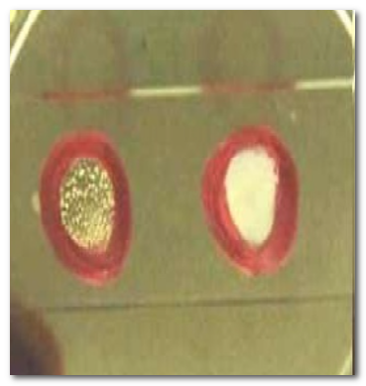
Serologic identification
As mentioned before, there are more than 200 serogroups of V. cholerae , among which O1 and 0139 serogroups are the causative agent of most of the epidemics and pandemics.
Serologic identification of V. cholera O1 and 0139 serogroup is the most rapid and specific method of identification.
It is carried out by slide agglutination test with the specific antisera.
Isolates of O1 serogroup is further divided into three serotypes
Ogawa
Inaba
and Hikojima (rare).

Slide 14
Summary of
Laboratory Diagnosis of V. cholerae
Collect stool sample
Place in transport medium and send to laboratory
Streak on selective or non-selective medium
Incubate 12-18 hours at 37°
Identify colonies
Perform a slide agglutination with polyvalent O1 group antiserum and type –specific antisera
OR
Perform biochemical tests such as string test, oxidase test,

Slide 15
Virulence factors:
1-Endotoxin: has only a negligible significance as a virulence factor
2-Enterotoxin (Cholera toxin – CT - ) : an exotoxin which is the main factor of pathogenity. It is antigenically and pharmacologically identical in all sero and biotypes of V. cholerae causing epidemic cholera.
3-Adherence factor providing ability to attach to the intestinal epithelial cells
4-Mucinase :causes extreme cellular desquamation
5-Vascular permeability factor

Slide 16
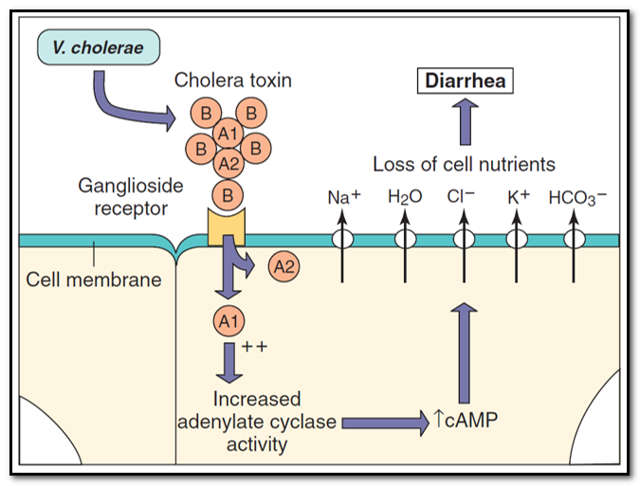
Vibrio cholera Enterotoxin :Mechanism of Action
-The cholera toxin is a complex A-B toxin. The B subunits are for binding and the A subunit is the active.
-The toxin binds ,through its (B) subunits to specific receptors on intestinal epithelial cells. The active portion of the A subunit is released and enters the intestinal epithelial cells.
The active portion interacts with G proteins that control the enzyme adenylate cyclase ,leading to catabolic conversion of adenosine triphosphate (ATP) to cyclic adenosine monophosphate (cAMP) .The rise in cAMP results in hypersecretion of water and electrolytes (Na+ ,K+, CL-, and HCO3- ) into intestinal lumen causing diarrhea.

Slide 17
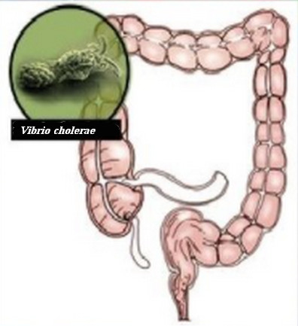
Pathogenesis of V. cholerae
Incubation period : 2-3 days
Source of infection: human carriers or patients with cholera and marine shellfish
Predisposing factors: Poor sanitation , overcrowding , malnutrition.
Mode of transmission : ingestion of contaminated food and water
Infective dose: organisms are very sensitive to gastric acid ,so high infective dose >10⁸ CFU is needed in normal person. Lower infective dose 10³ -10⁵ CFU in patients having reduced gastric acid secretion (achlorhydria or hypochlorhydria and patients using antacid treatment).
Clinical Findings : sudden onset of nausea and vomiting and profuse diarrhea with abdominal cramps. Stools, which resemble ``rice water``, contain mucus, epithelial cells ,and large number of Vibrios. There is rapid loss of fluid and electrolytes, which leads to profound dehydration, circulatory collapse ,and anuria which if not replaced adequately may lead to death.

Slide 18
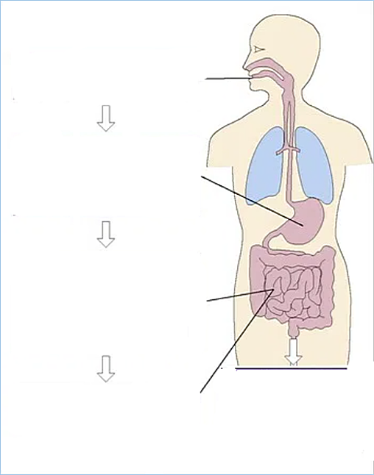
Pathogenesis of V. cholerae
(Summary)
Ingestion of contaminated food or water (in large number)
The bacteria is sensitive to gastric acid so large dose needed to cause disease unless patient achlorhydric ( reduced gastric acid )or taking antacids
Colonization of small intestine:
-Bacterial motility (polar flagella)
-Production of mucinase
Attachment to specific receptors
Massive loss of fluid and electrolytes
(no damage to intestinal epithelial cells, no blood or leucocytes in stool)
Toxin production

Slide 19
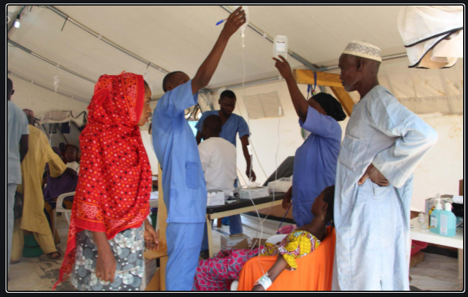
Treatment of Cholera
1- Fluid and electrolytes replacement.
2- Acid base balance adjustment.
3- Antibiotics such tetracycline.

Slide 20
Preventive measures
1-Education and improvement of sanitation
2-Pure water supply and clean food preparation
3-Proper sewage disposal
4-Isolation of patients
5-Detection of carriers
6-Vaccination
Immunity
An attack of cholera is followed by immunity to reinfection but the duration and degree of immunity are unknown. Re- attacks are not common for 6-12 months.

Slide 21
Other Vibrio Infections
V. Cholerae serogroups O1 and O139 cause cholera in humans
- Other Vibrios such as Vibrio cholera serogroups non-O1/ non-O139 and Vibrio parahaemolyticus may cause cholera-like diarrhea ,gastroenteritis and extraintestinal sepsis
Vibrio parahaemolyticus:
It is a halophilic (salt-loving) Vibrio associated with enteritis produced by thermostable direct hemolysin.
Infection is acquired by ingestion of raw or improperly cooked sea foods.
V. vulnificus:
it is a halophilic vibrio, which ferments lactose associated with wound infections as well as fatal septicemias.
Non-O1/0139 serogroups of V. cholerae: cause diarrhea

Slide 22
Other Vibrionaceae genera
Vibrios-related organisms
Aeromonas
&
Plesiomonas

Slide 23
Aeromonas
-a gram negative facultative anaerobic rod that morphologically resembles members of the family Enterobacteriaceae
-16 species have been recognized most of which are associated with human disease. The most important pathogens are :
Aeromonas hydrophila , Aeromonas caviae, and Aeromonas veroni bivar sobria.
-The organisms are present in fresh and brackish water throughout the world. Motile species have single polar flagellum. Non motile species apparently are not associated with human disease.
-Infection is acquired by ingestion or exposure to contaminated water or food
-The two major diseases associated with Aeromonas are gastroenteritis and wound infections (with or without bacteremia). It causes opportunistic systemic disease in immunocompromised person.

Slide 24
Plesiomonas
Single species Plesiomonas shigelloides
-The bacteria are oxidase positive
and have multiple polar flagella (lophotrichous)
-Found in soil and aquatic environment (fresh or estuarine water) , some cold blooded animals ( such as reptiles, fishes, amphibians ) are carriers
Infection is acquired by ingestion or exposure to contaminated water or sea food or through occupational exposure (fish handlers, zookeeper)
Primarily causes gastroenteritis or rarely extraintestinal infections

